Slide 1

TACCS™
(Touch Assisted Command and Control System)
Supply Chain Technology / Risk Management Capabilities-
Energy Management
Company Name: Priority 5 Holdings, Inc.
Company Website: Priority5.com
POC: Chuck Miller
Title: President & CEO
Address: 75 2nd Ave., Suite 450,
Needham, MA 02494
Email: chuck.miller@priority5.com
Contact Phone: 617-391-9501
Date of Submittal: July 22, 2024
This solution brief includes data that shall not be disclosed outside the Government, except to non-government personnel for evaluation purposes, and shall not be duplicated, used, or disclosed - in whole or in part - for any purpose other than to evaluate this submission. If, however, an agreement is awarded to this company as a result of - or in connection with - the submission of this data, the Government shall have the right to duplicate, use, or disclose the data to the extent agreed upon by both parties in the resulting agreement. This restriction does not limit the Government's right to use information contained in this data if it is obtained from another source without restriction. The data subject to this restriction are contained in sheets 2-15.

Slide 2
De-Risking the Energy Supply Chain
The United States requires the ability to rapidly understand the complex operational energy landscape in theater and its capacity to support the energy demands of US forces at any given time. There is currently no solution that would enable mission planners or field commanders at echelon to balance constantly changing energy status and anticipate needs driven by multiple interdependent mission operations requirements emanating from:
Traditional training, movement and sustainment
New energy-constrained weaponry, transportation (e.g., alternatively fueled) and communications (e.g., mesh networks, sensor-monitored warfighters)
Contested supply chains (kinetic, and cyber) that can reach from the front line into the depths of the DIB
Changing mission constraints originating from external bodies (e.g., domestic pressures, needs of allies)
Disrupted just In time deliveries to the point of need
Although efforts are currently underway to model inter- and intra- theater fuel supply chains, nevertheless no tool currently exists to equip field commanders charged with making real time operational decisions with a way to model potential tactical limitation and logistics bottlenecks, and evaluate alternative courses of action (CoA).
The objective of the proposed effort is to modify TACCS™, an existing mission-based commercial technology, to meet these needs. TACCS™will integrate into war gaming exercises and then be used in the same way in the field to reduce mission risks that arise from an inability to plan for, monitor and modify energy-related operational constraints. The modified solution will present an integrated geospatial visualization of energy-related variables, environmental factors and logistics support requirements that facilitates alternative COA planning at echelon and rapidly adapts to reflect changes in real-world circumstances that require a knowledgeable response to increase the likelihood of mission success.

Slide 3
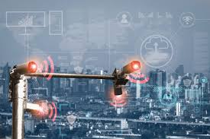



Visualizing a Changing Energy Environment
Technology
Energy Aware COP
Threat analytics
Applications to Planning
“What If” scenarios
Recovery optimization
Convoy reduction
Applications to Operations
Workflows/COAs
Tactical and strategic mission impacts
Open Architecture Fusing
HUMINT, SIGINT, SENSOR DATA
AI Expert System Analytics
ANTICIPATE ENERGY THREATS
Common Operating Picture
DISPLAYING ENERGY IMPACTS
Mission Based Decision Making TACTICAL/STRATEGIC DASHBOARDS

Slide 4
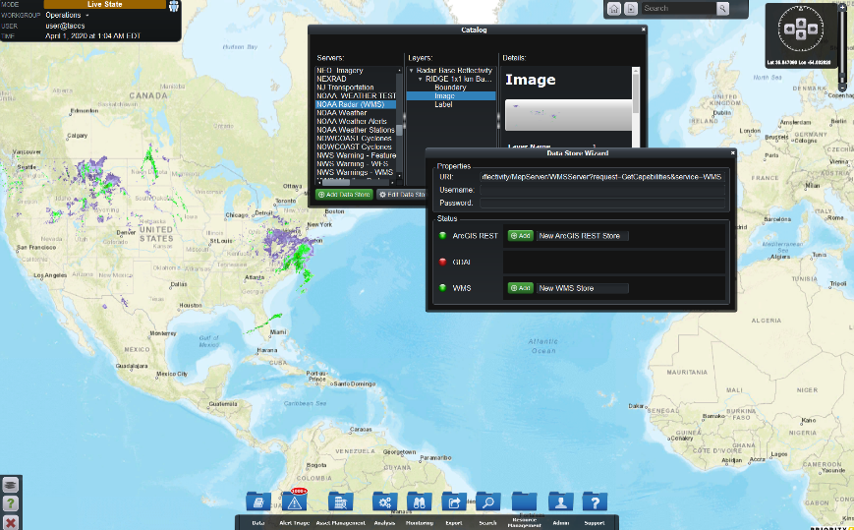
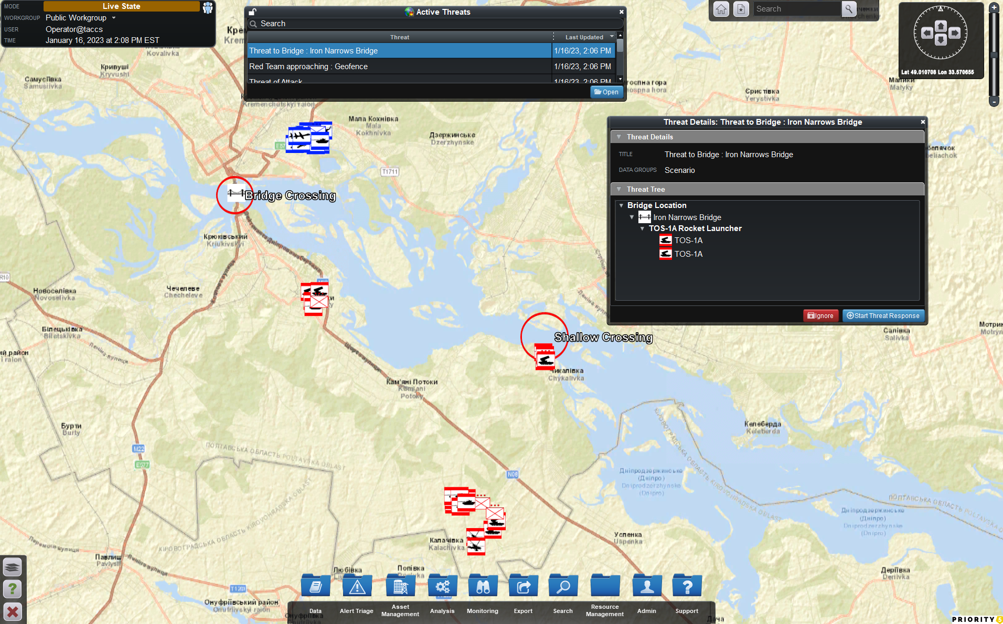
The Technology
TACCS™
Provides immediate situational awareness
through mission-based dashboards and COP
Identifies potential disruptions
using AI Threat Analytics that combines HUMINT and sensor data
Shows direct and cascading impacts
of disruptions on critical assets and infrastructure
Supports “What If” testing of COAs
to anticipate consequences and informed decision making at echelon
Displays workflows and tracks mission impacts
that incorporate damage recovery estimates based on available resources
Note: all illustrations used in this presentation are hypothetical based on publicly available sources

Slide 5
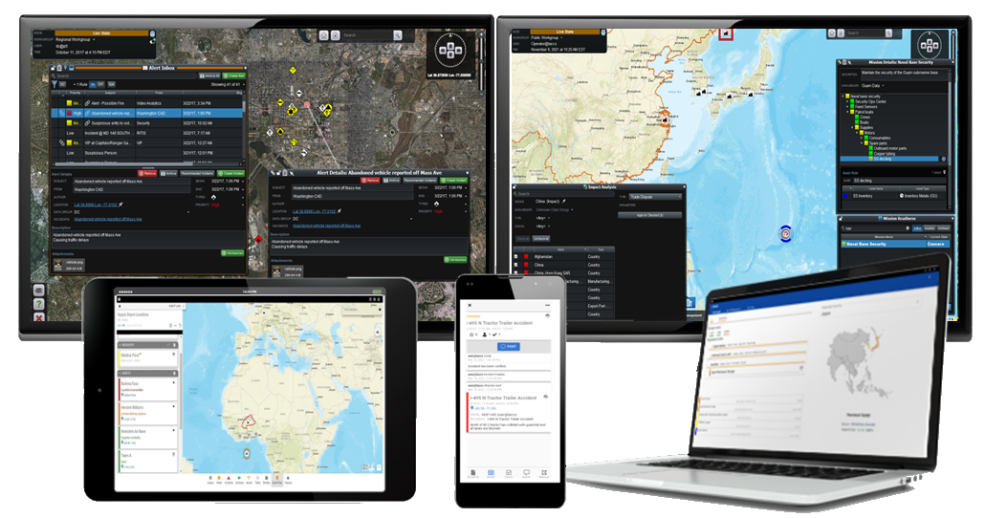
TACCS™ Provides the System of Systems
TACCS­™ is an open architecture mission-based situational awareness and decision support software
Power users in a command post have a full set of capabilities
Troops in the field access operational tools from a tablet or smartphone
Transient forces receive immediate alerts if they are in danger
Flag officers monitor real time mission status at echelon
TACCS™ RBAC permits both strategic and tactical users at all levels to share a COP specifically designed for their needs, and enables collaborative decision making at the edge

Slide 6
Open Architecture
TACCS™ open architecture readily integrates new technologies, which is essential in the rapidly evolving operational energy management field
Resulting in:
Quickly adding data feeds, sensors, and problem-specific technology solutions
Verifying that the latest technology is available by incorporating the thinking of industry leaders from academia
Providing access to unbiased management from the public and private sector for assistance in contracting and administration, and
Demonstrating the solution in operational vignettes
… A process that takes weeks, not years

Slide 7

Warfighter Modifications
Priority 5’s dual-use capabilities can be configured for tactical military applications
Current customers include national (e.g., Amtrak, Centers for Disease Control, DoD) and international (e.g., KSA, Philippines) installations
Complete integration with TAK and ADVANA
- Threat analytics updated to include sensors, HUMINT, and SIGINT
- Assets and workflows configured to conform to military requirements
- Mission structures based on integrating strategic and tactical planning and execution
Required personnel clearances are in place and TACCS™ has
previously been granted ATO on NIPRNet and SIPRNet

Slide 8
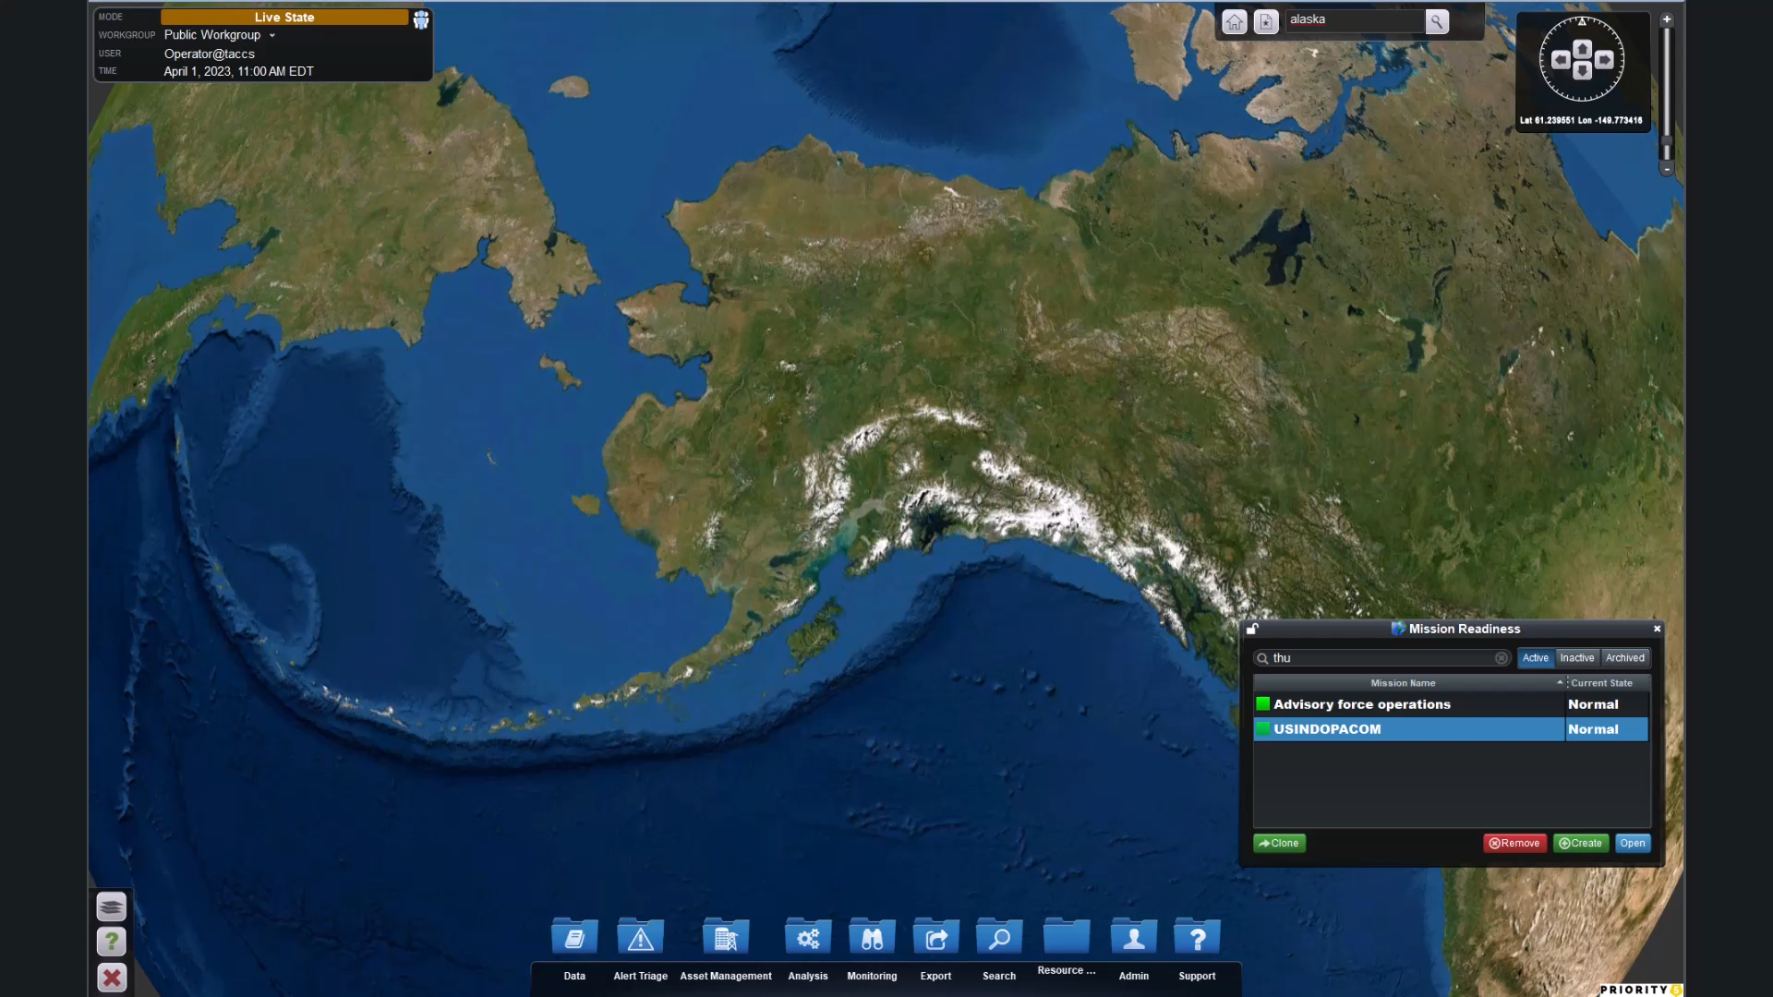
Representative Application - Taiwan
Earthquake damage to JBER has increased the risk of adversarial activity in Taiwan
INDOPACOM mission readiness impacted, and an elevated threat indicated by Chinese activity
Command Post for US advisory force established that includes diesel and electric vehicles, and DE weapons
The command post microgrid is powered by diesel generators, fuel cells, grid connection
Main supply points are Port of Yunlin to the north for diesel fuel and Qian Zhen Qu to the south for shipping containers

Slide 9
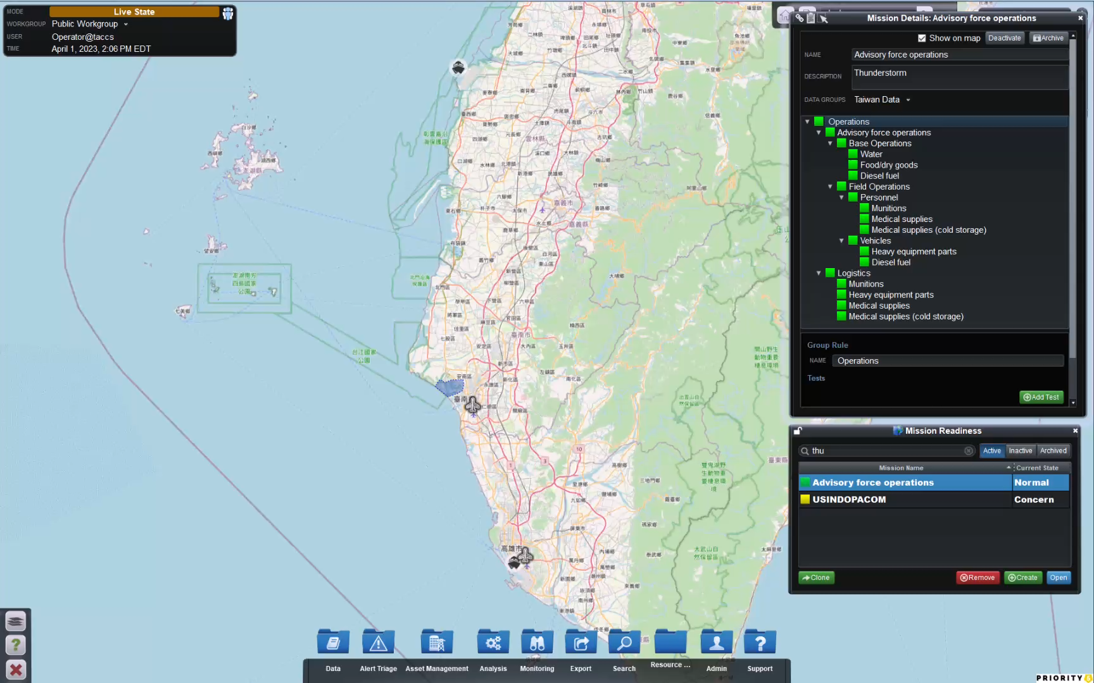
Planning - Potential Disruptions
Operational energy is identified as a key element in mission planning
Supply chains are modeled to indicate direct and cascading damage to CI/KR as well as mission impacts
Single fuel port and proximity to the adversary makes the loss of bulk diesel fuel supply from the port likely
The impact of disruptions can be tested by simulating a channel blockade and viewing mission impacts

Slide 10
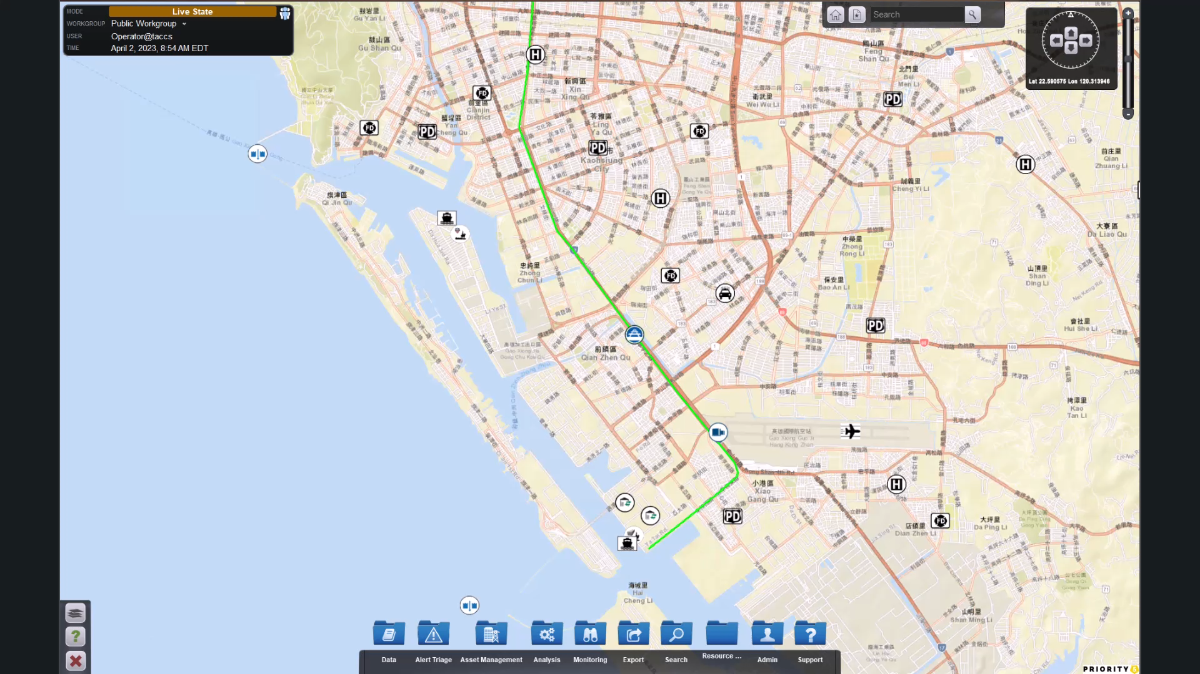
Strategic Impact - Convoys
“What If” analysis shows impacts of supply chain disruptions
The TACCS™ recovery module shows time to repair damage to container port , indicating need for fuel convoy from the north
The addition of a micro nuclear power plant reduces the need for multiple convoys
Corrective action is prioritized based on the mission impacts and resource availability

Slide 11
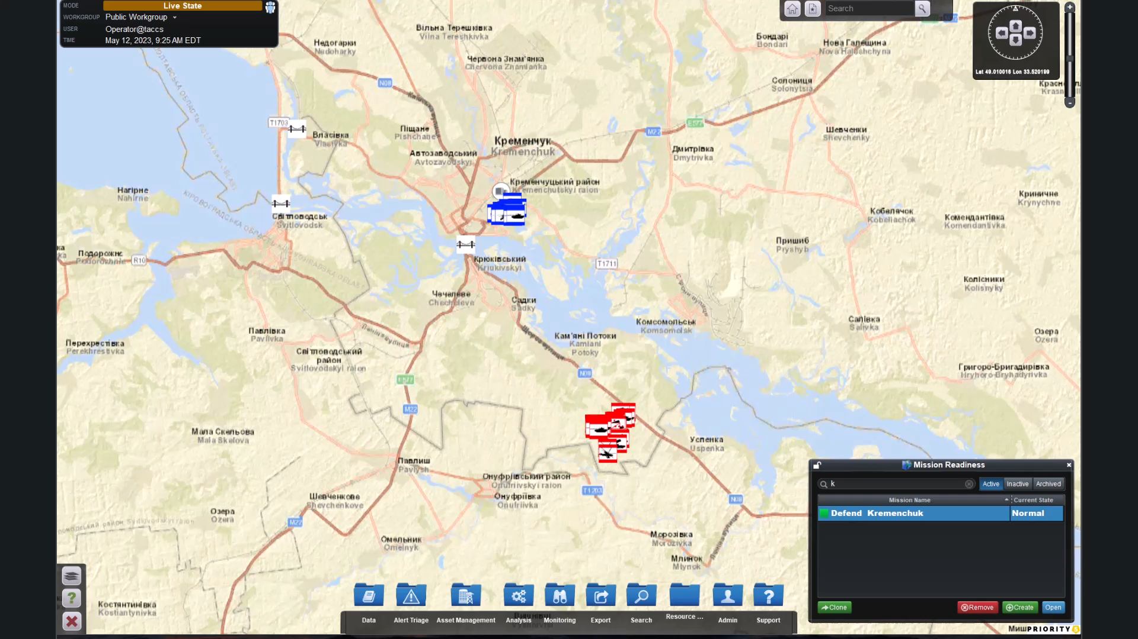
Execution - FCP
The Blue Force is defending a town accessible to the Red Force by bridge or a shallow river crossing
Armaments include DE weapons, and diesel and electric vehicles
Need power to keep electric vehicle mounted DE weapons at full charge
User displays are configured for quick access to data that impacts both weapons and mobility

Slide 12
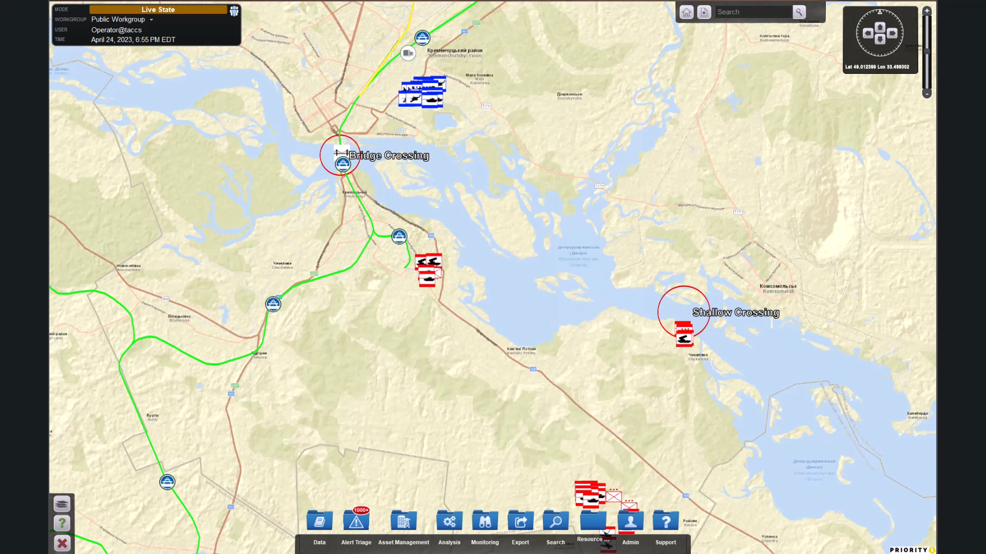
Alternative COAs
“What If” analytics are used to anticipate adversary tactics
Critical diesel fuel supplies are available from the south and the east
Considerations include cascading impacts on supply chains and operational energy
Strategies can be modified based on the availability of energy resources
Real time threat monitoring , geofencing, etc. can be set to optimize planned response

Slide 13
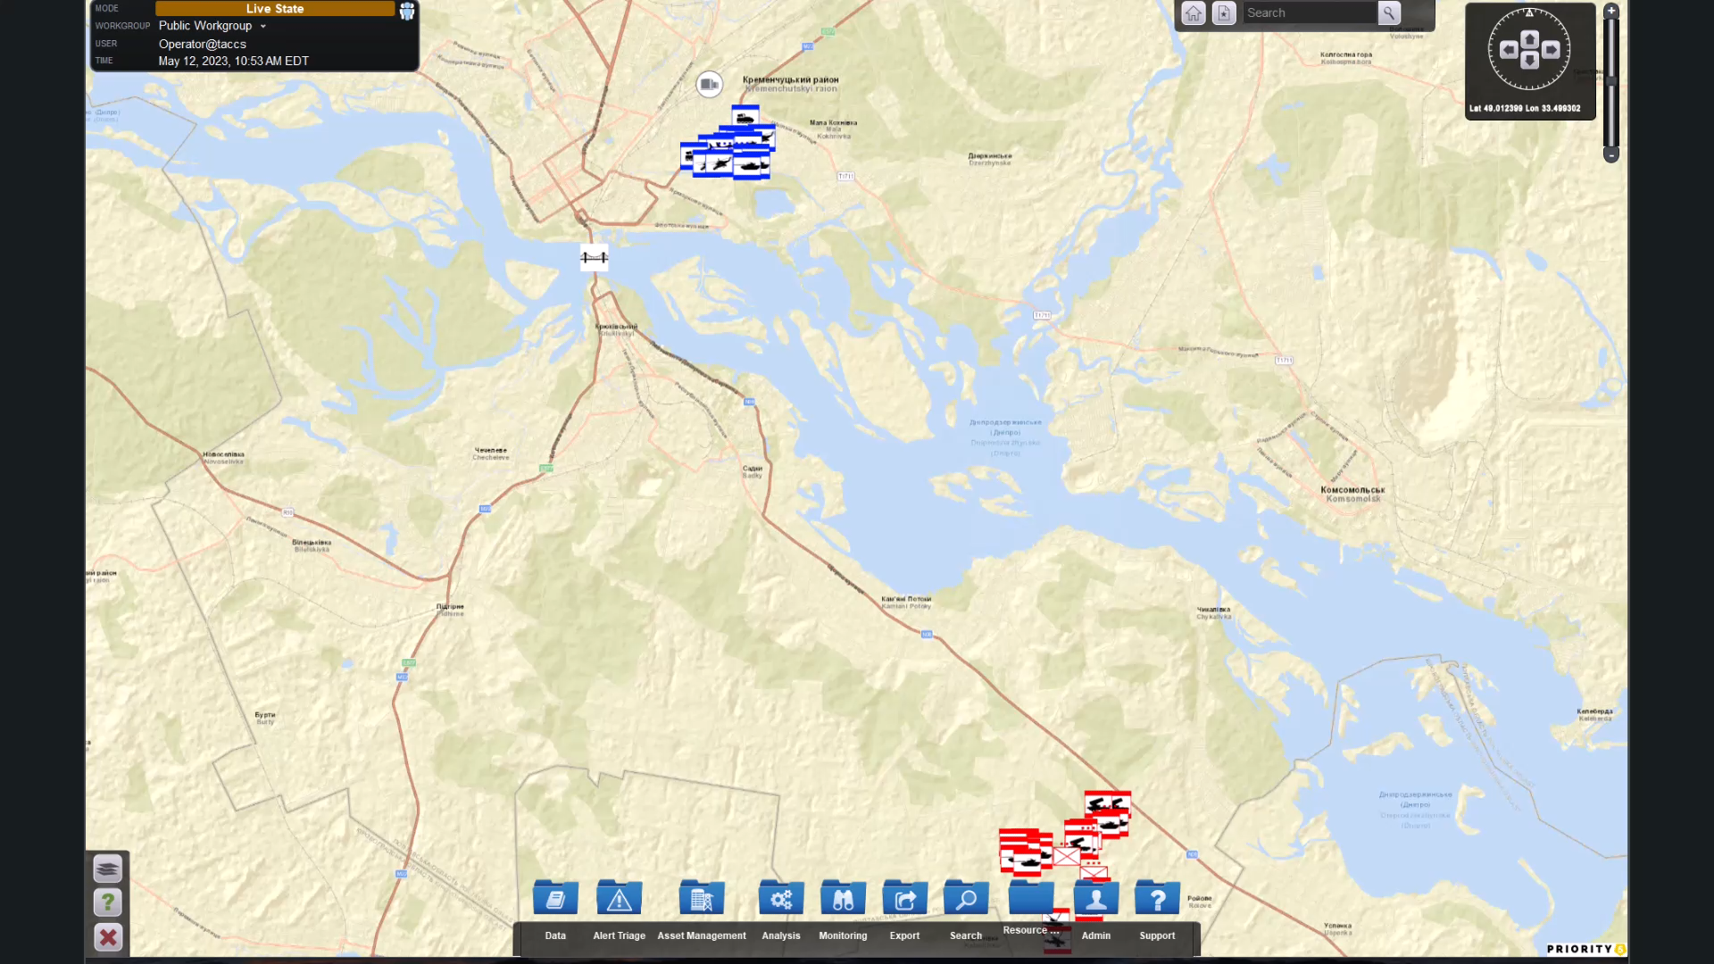
Maintain OE SA
Energy planning informs the tactical response
TACCS™ threat analytics identify combinations of sensor feeds/alerts/asset and mission status changes that indicate potential adverse conditions
- Pattern of life
- Geofence
As assets are deployed, operational status is updated based on the combined impact of kWh depletion of weapons and mobility

Slide 14
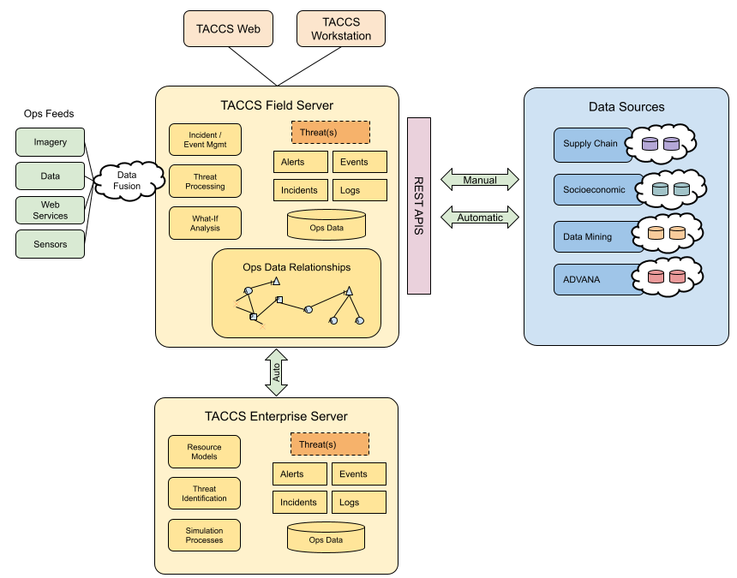
Path Forward
Deployment Architecture

Slide 15
ROM Price
ROM Price and Payment Terms
Software - I year Dev, 6 mos Prod TACCS™ licenses for battalion $350,000
Configuration, training, CONOPs and exercise support $400,000
Total Year One $750,000
Payment terms
Software: 50% on installation of Dev, net 15
50% on installation of Prod net 15
Services FFP, net 30 upon completion of milestones
Assumptions
Network hardware and configuration by the Government
Field mesh network connections provided by the Government
Interfaces with ADVANA and TAK provided by the Government

